Slide 1
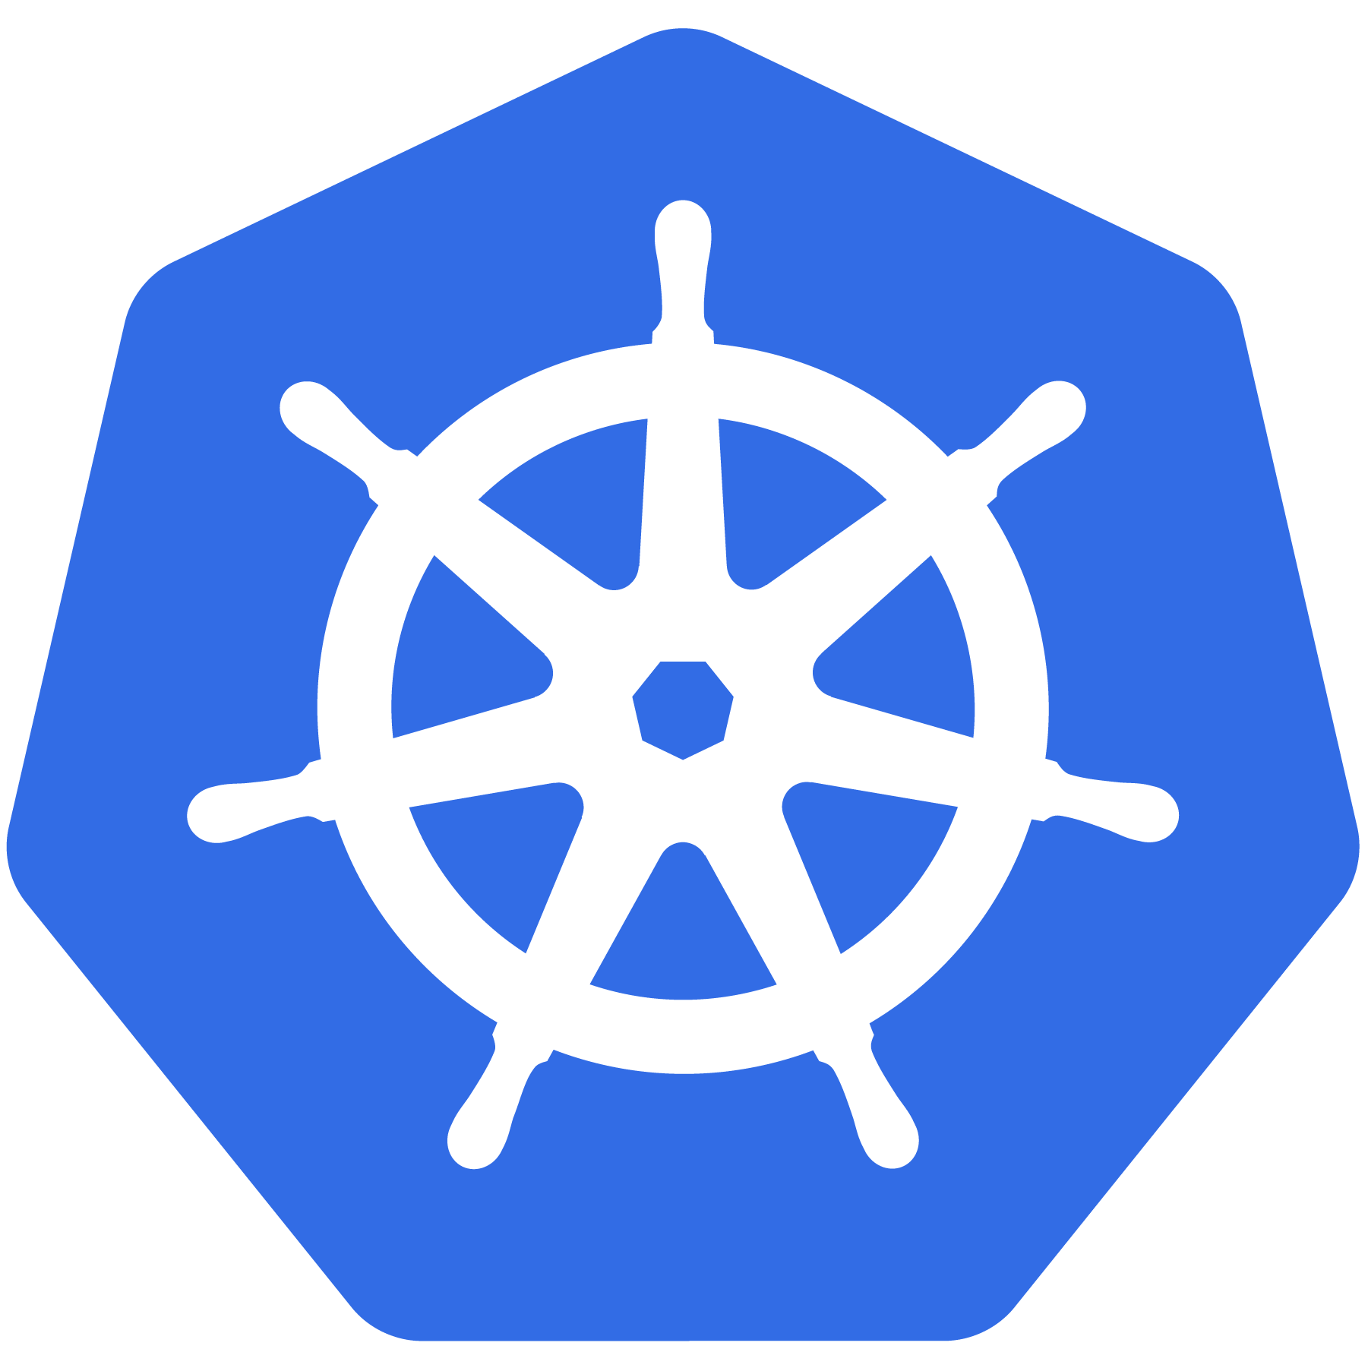

Kubernetes
Adapted from:
https://docs.google.com/presentation/d/1zrfVlE5r61ZNQrmXKx5gJmBcXnoa_WerHEnTxu5SMco
An Introduction
CC-BY 4.0
Kubernetes v1.15 07/2019

Slide 2
Project
Overview
Notes:
Quick overview of the project and what Kubernetes it
Note: This is currently for v1.12

Slide 3
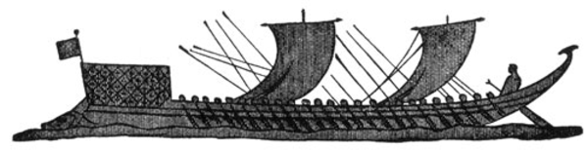
What Does “Kubernetes” Mean?
Greek for “pilot” or
“Helmsman of a ship”
Image Source
Notes:
The first question always asked
There is also the abbreviation of K8s -- K, eight letters, s

Slide 4
What is Kubernetes?
Project that was spun out of Google as an open source container orchestration platform.
Built from the lessons learned in the experiences of developing and running Google’s Borg and Omega.
Designed from the ground-up as a loosely coupled collection of components centered around deploying, maintaining and scaling workloads.
Notes:
There’s a phrase called Google-scale. This was developed out of a need to scale large container applications across Google-scale infrastructure
borg is the man behind the curtain managing everything in google
Kubernetes is loosely coupled, meaning that all the components have little knowledge of each other and function independently.
This makes them easy to replace and integrate with a wide variety of systems

Slide 5
What Does Kubernetes do?
Known as the linux kernel of distributed systems.
Abstracts away the underlying hardware of the nodes and provides a uniform interface for workloads to be both deployed and consume the shared pool of resources.
Works as an engine for resolving state by converging actual and the desired state of the system.
Notes:
linux kernel of distributed systems
Sort of like a hypervisors, in that it abstracts away the underlying host resources and shares them in a normalized way.
the underlying substrate or platform to build your applications and tools on top of
Think of Kubernetes like a higher-level language for your application architecture.
you describe what you need and it tries to resolve it
with that in mind, it acts as an engine to resolve state using the abstracted resources to deploy and manage your application.
It is declarative, and not imperative. You tell it or “declare” what you want, and it figures out the rest.
imperative you tell something every step you want it to do
declarative you tell it what you want it to be, and it figures it out
e.g. ‘I want 5 instances of x’ and it just does it, if something dies, it brings it back to get to 5

Slide 6
Decouples Infrastructure and Scaling
All services within Kubernetes are natively Load Balanced.
Can scale up and down dynamically.
Used both to enable self-healing and seamless upgrading or rollback of applications.
Notes:
A lot of key components are batteries-included

Slide 7
Self Healing
Kubernetes will ALWAYS try and steer the cluster to its desired state.
Me: “I want 3 healthy instances of redis to always be running.”
Kubernetes: “Okay, I’ll ensure there are always 3 instances up and running.”
Kubernetes: “Oh look, one has died. I’m going to attempt to spin up a new one.”
Notes:
The instance will have a new IP and likely be on a different host, but Kubernetes gives the primitives for us to ‘not care’ about that.

Slide 8
What can Kubernetes REALLY do?
Autoscale Workloads
Blue/Green Deployments
Fire off jobs and scheduled cronjobs
Manage Stateless and Stateful Applications
Provide native methods of service discovery
Easily integrate and support 3rd party apps
Notes:
Everything here requires some level of configuration

Slide 9
Most Importantly...
Use the SAME API across bare metal and EVERY cloud provider!!!
Notes:
Single biggest value-add Kubernetes can offer

Slide 10

Who “Manages” Kubernetes?
The CNCF is a child entity of the Linux Foundation and operates as a vendor neutral governance group.
Notes:
CNCF is a sub-foundation of the Linux Foundation
A vendor neutral entity to manage “cloud native” projects
Projects that are “cloud native” generally focus on:
containers
dynamic orchestration
enable “microservice” deployment methodologies
can be logging, monitoring, containerizers etc
Kubernetes was the first project under the CNCF, and the first to be “graduated”

Slide 11
A Couple
Key Concepts...
Notes:
There are a few small things we should mention
It’s kind of a chicken and egg problem. But we need to talk about these before the stuff that supports and extends it

Slide 12
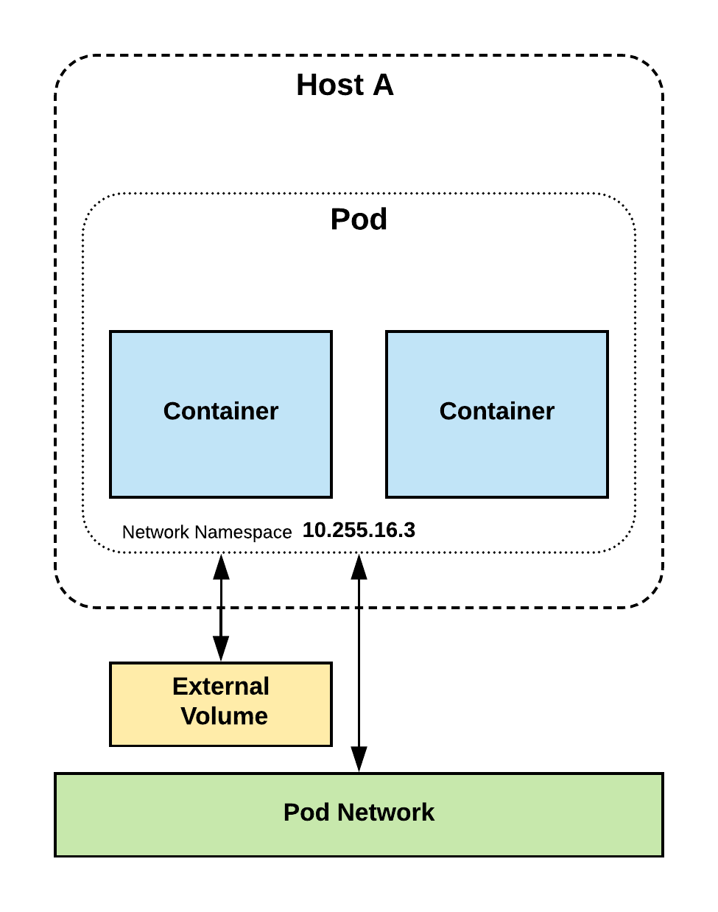
Pods
Atomic unit or smallest “unit of work”of Kubernetes.
Pods are one or MORE containers that share volumes, a network namespace, and are a part of a single context.

Slide 13
Pods
They are
also
Ephemeral!
Notes:
Higher level objects manage replicas, fault tolerance etc.

Slide 14
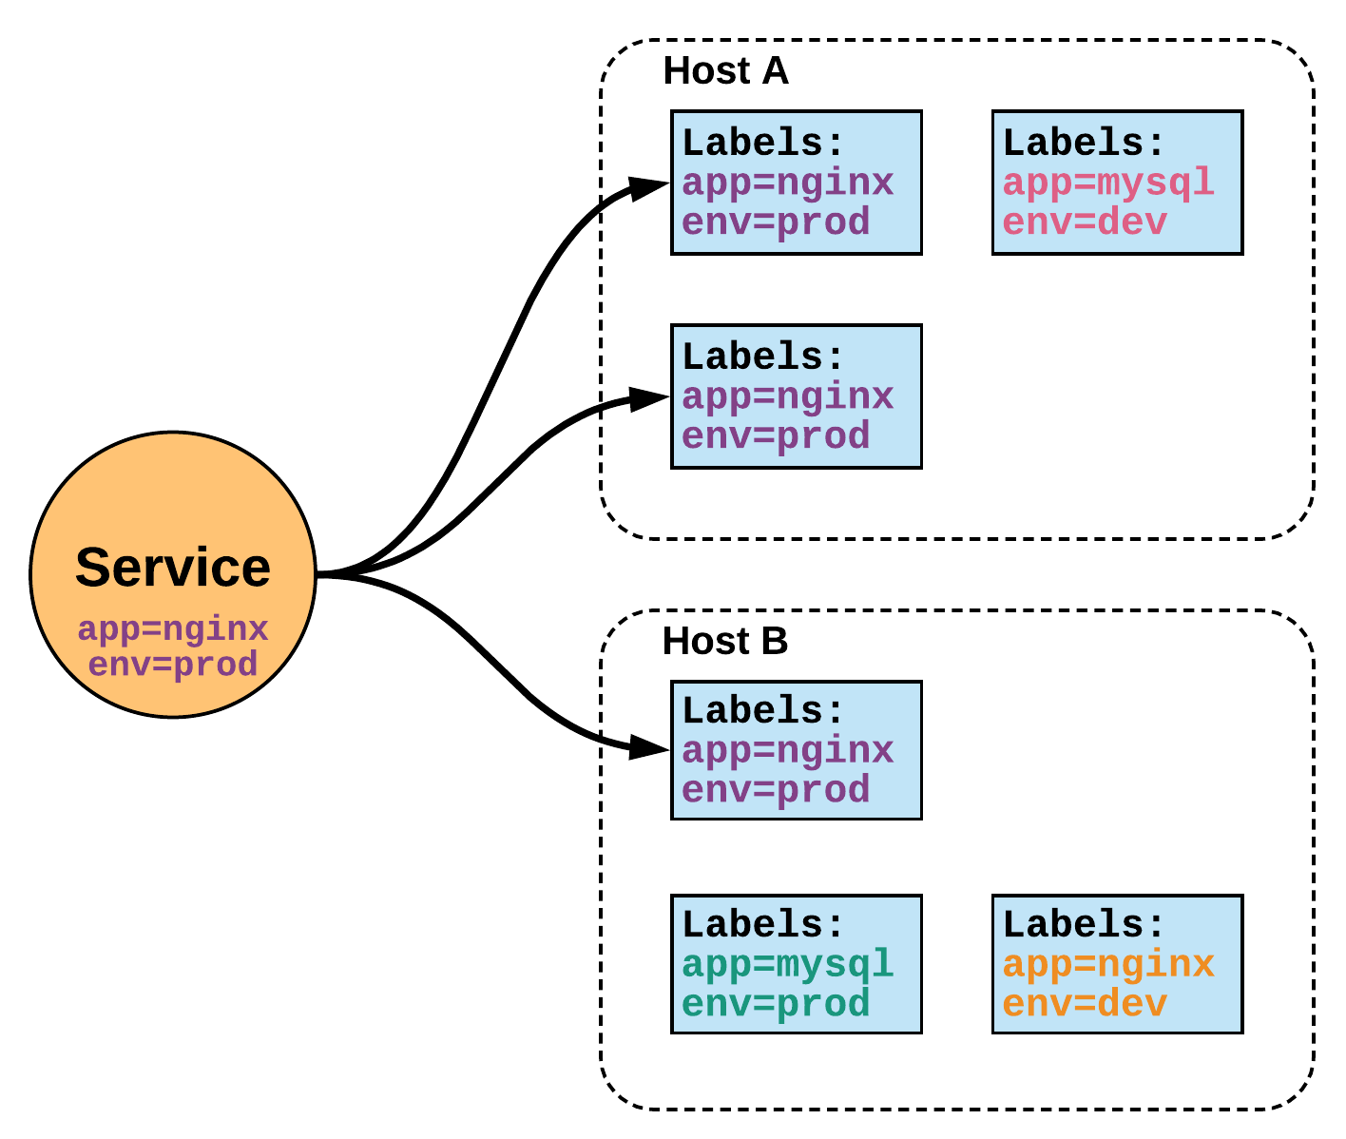
Services
Unified method of accessing the exposed workloads of Pods.
Durable resource
static cluster IP
static namespaced DNS name
Notes:
While this may seem like a technical definition, in practice it can be viewed more simply:
A service is an internal load balancer to your pod(s). You have 3 HTTP pods scheduled? Create a service, reference the pods, and (internally) it will load balance across the three.

Slide 15
Services
Unified method of accessing the exposed workloads of Pods.
Durable resource
static cluster IP
static namespaced DNS name
NOT Ephemeral!
Notes:
Services are persistent objects used to reference ephemeral resources

Slide 16
Architecture
Overview
Notes:
Get right into the meat of the internals.

Slide 17
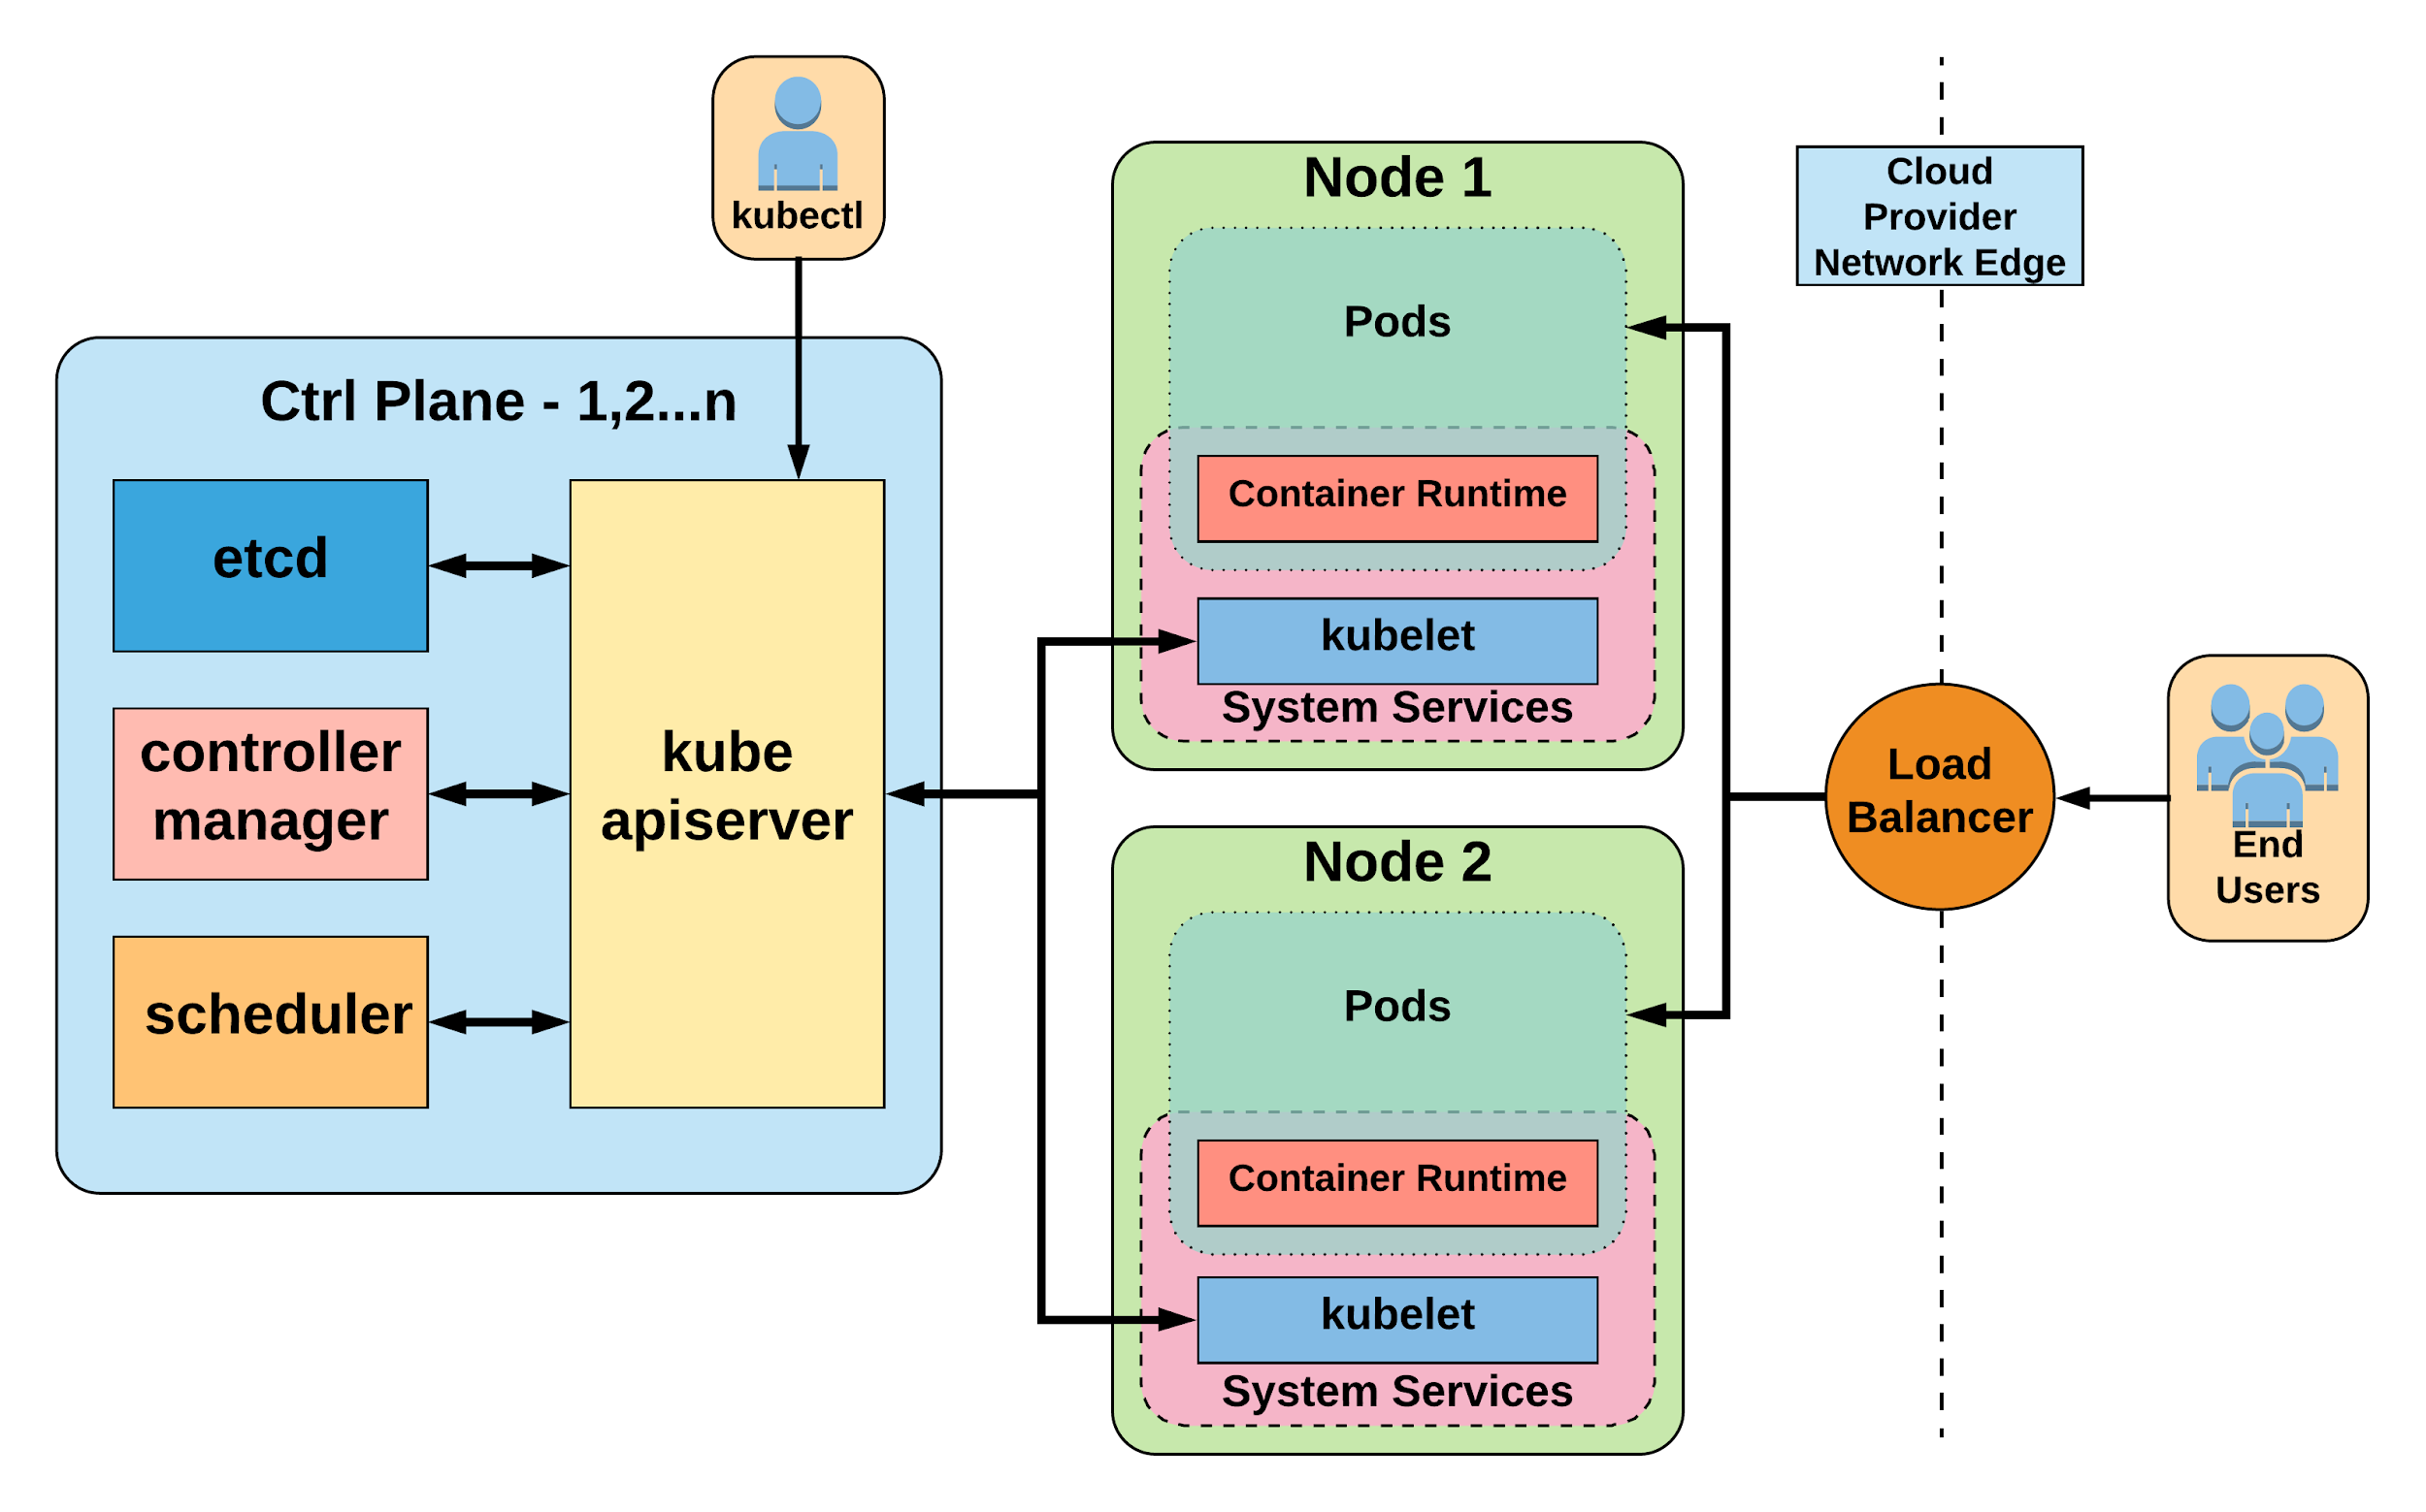
Notes:
General High Level Architecture Overview
There is 1-n number of masters or control plane servers, usually deployed in 1,3,5,7 configurations
Up to 5000 “worker nodes”
This is what it’s certified to and E2E tests are built for

Slide 18
Control Plane Components
Architecture Overview

Slide 19
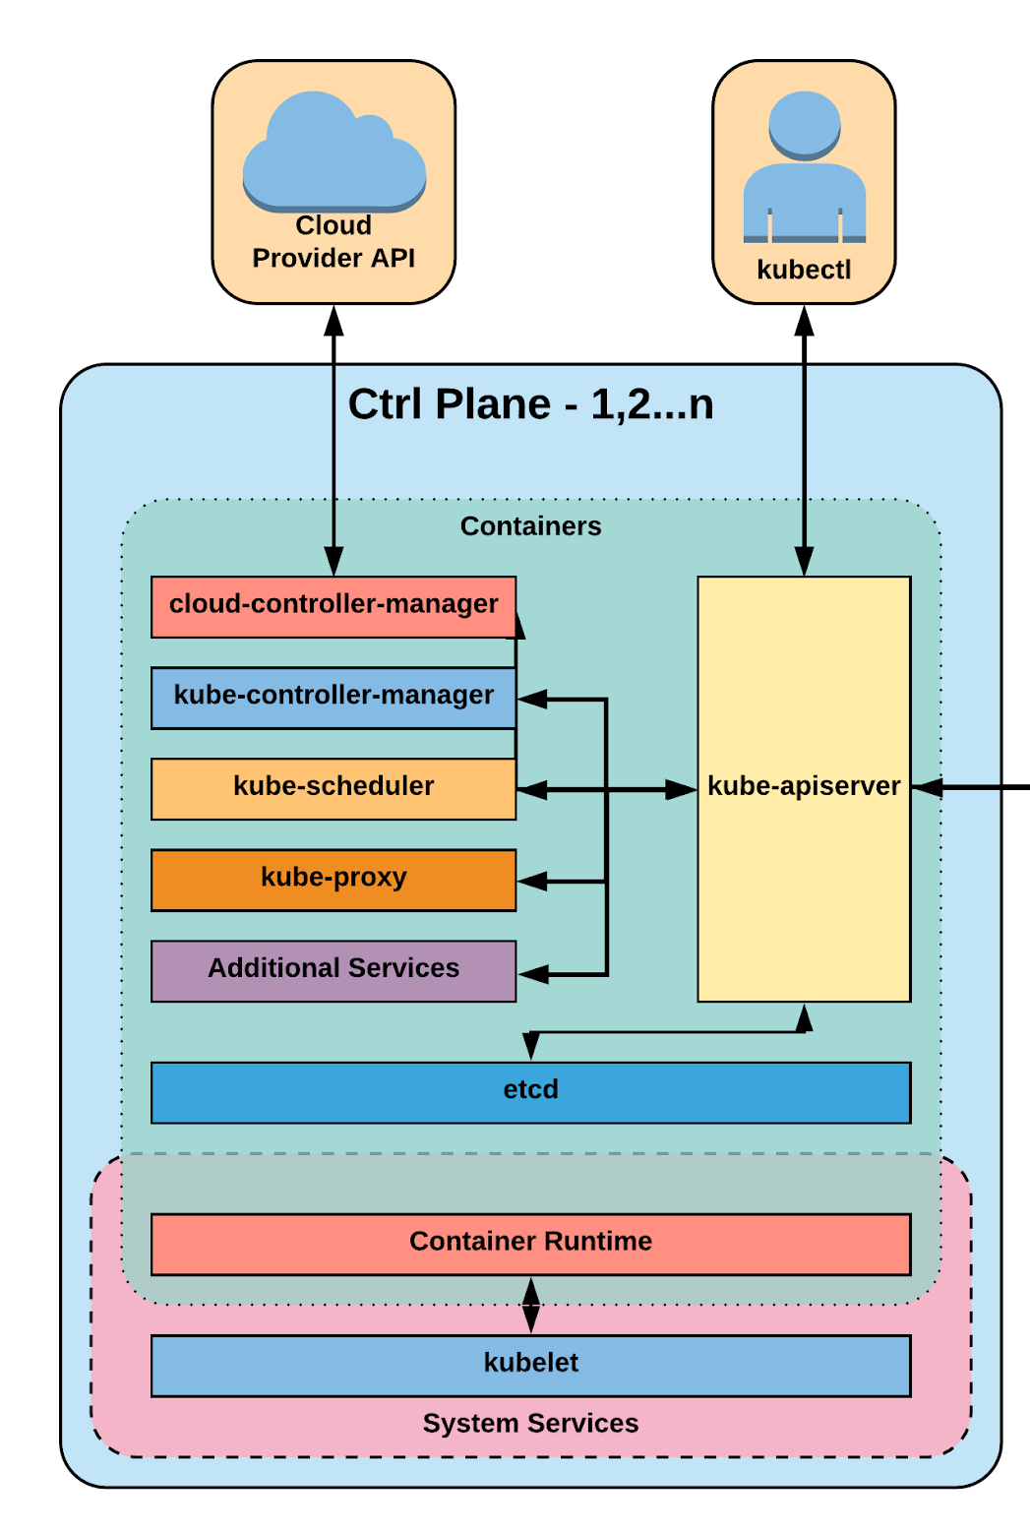
Control Plane Components
kube-apiserver
etcd
kube-controller-manager
kube-scheduler
Notes:
Kube-apiserver
Gate keeper for everything in kubernetes
EVERYTHING interacts with kubernetes through the apiserver
Etcd
Distributed storage back end for kubernetes
The apiserver is the only thing that talks to it
Kube-controller-manager
The home of the core controllers
kube-scheduler
handes placement

Slide 20
kube-apiserver
Provides a forward facing REST interface into the kubernetes control plane and datastore.
All clients and other applications interact with kubernetes strictly through the API Server.
Acts as the gatekeeper to the cluster by handling authentication and authorization, request validation, mutation, and admission control in addition to being the front-end to the backing datastore.
Notes:
provides forward facing REST interface into k8s itself
everything, ALL components interact with each other through the api-server
handles authn, authz, request validation, mutation and admission control and serves as a generic front end to the backing datastore

Slide 21

etcd
etcd acts as the cluster datastore.
Purpose in relation to Kubernetes is to provide a strong, consistent and highly available key-value store for persisting cluster state.
Stores objects and config information.
Notes:
is the backing datastore
extremely durable and highly available key-value store
was developed originally by coreos now redhat
however it is in the process of being donated to the CNCF

Slide 22
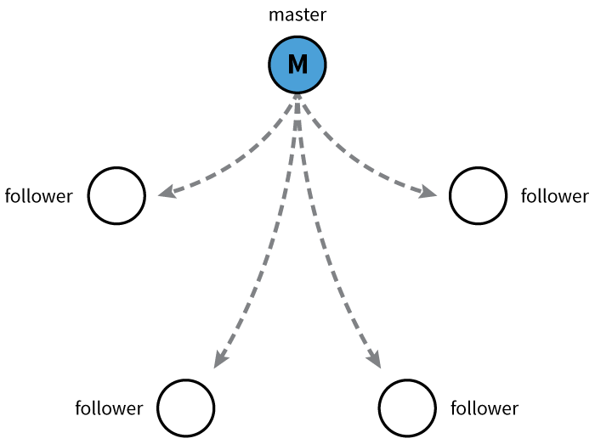
etcd
Uses “Raft Consensus” among a quorum of systems to create a fault-tolerant consistent “view” of the cluster.
https://raft.github.io/
Image Source
Notes:
provides HA via raft
requires quorum of systems
Typically aim for 1,3,5,7 control plane servers

Slide 23
kube-controller-manager
Serves as the primary daemon that manages all core component control loops.
Monitors the cluster state via the apiserver and steers the cluster towards the desired state.
List of core controllers: https://github.com/kubernetes/kubernetes/blob/master/cmd/kube-controller-manager/app/controllermanager.go#L344
Notes:
Its the director behind the scenes
The thing that says “hey I need a few more pods spun up”
Does NOT handle scheduling, just decides what the desired state of the cluster should look like
e.g. receives request for a deployment, produces replicaset, then produces pods

Slide 24
kube-scheduler
Verbose policy-rich engine that evaluates workload requirements and attempts to place it on a matching resource.
Default scheduler uses bin packing.
Workload Requirements can include: general hardware requirements, affinity/anti-affinity, labels, and other various custom resource requirements.
Notes:
scheduler decides which nodes should run which pods
updates pod with a node assignment, nodes poll checking which pods have their matching assignment
takes into account variety of reqs, affinity, anti-affinity, hw resources etc
possible to actually run more than one scheduler
example: kube-batch is a gang scheduler based off LSF/Symphony from IBM

Slide 25
Node
Components
Architecture Overview

Slide 26
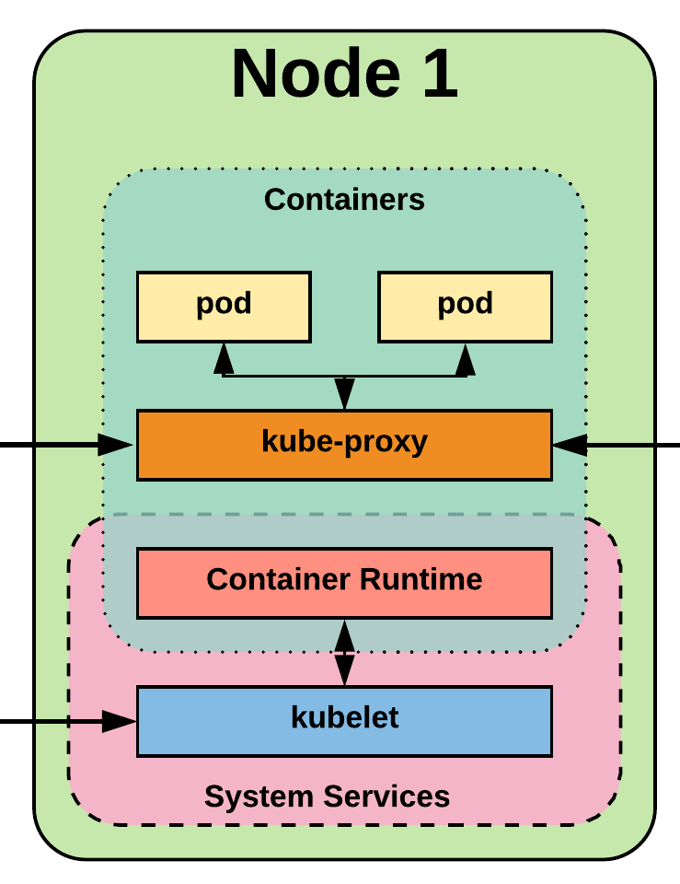
Node Components
kubelet
kube-proxy
Container Runtime Engine
Notes:
Kubelet
Agent running on every node, including the control plane
Kube-proxy
The network ‘plumber’ for Kubernetes services
Enables in-cluster load-balancing and service discovery
Container Runtime Engine
The containerizer itself - typically docker

Slide 27
kubelet
Acts as the node agent responsible for managing the lifecycle of every pod on its host.
Kubelet understands YAML container manifests that it can read from several sources:
file path
HTTP Endpoint
etcd watch acting on any changes
HTTP Server mode accepting container manifests over a simple API.
Notes:
the single host daemon required for a being a part of a kubernetes cluster
can read pod manifests from several different locations
workers: poll kube-apiserver looking for what they should run
masters: run the master services as static manifests found locally on the host

Slide 28
kube-proxy
Manages the network rules on each node.
Performs connection forwarding or load balancing for Kubernetes cluster services.
Available Proxy Modes:
Userspace
iptables
ipvs (default if supported)
Notes:
kube-proxy is the plumber
creates the rules on the host to map and expose services
uses a combination of ipvs and iptables to manage networking/loadbalancing
ipvs is more performant and opens the door to a wider feature set (port ranges, better lb rules etc)

Slide 29
Container Runtime Engine
A container runtime is a CRI (Container Runtime Interface) compatible application that executes and manages containers.
Containerd (docker)
Cri-o
Rkt
Kata (formerly clear and hyper)
Virtlet (VM CRI compatible runtime)
Notes:
Kubernetes functions with multiple different containerizers
Interacts with them through the CRI - container runtime interface
CRI creates a ‘shim’ to talk between kubelet and the container runtime
cri-o is a cool one that allows you to run any oci compatible image/runtime in Kubernetes
kata is a super lightweight KVM wrapper

Slide 30

Notes:
The complete picture

Slide 31
Networking
Architecture Overview
Notes:
Networking is where people tend to get confused, they think of it like Docker
The backing cluster network is a plugin, does not work just out of the box

Slide 32
Kubernetes Networking
Pod Network
Cluster-wide network used for pod-to-pod communication managed by a CNI (Container Network Interface) plugin.
Service Network
Cluster-wide range of Virtual IPs managed by kube-proxy for service discovery.
Notes:
Unlike Docker, every pod gets its own cluster wide unique IP, and makes use of the CNI plugin
Services are a separate range of static non-routable virtual IPs that are used like an internal LB or static IP
Service IPs are special and can’t be treated like a normal IP, they are a ‘mapping’ stored and managed by kube-proxy
Pod IPs are pingable
Service IPs are not

Slide 33
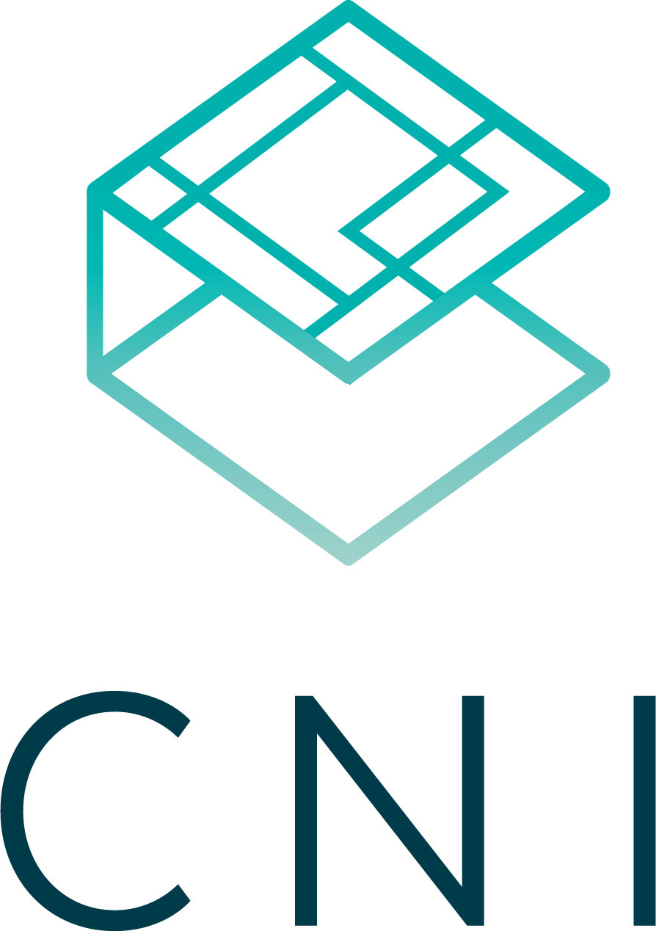
Container Network Interface (CNI)
Pod networking within Kubernetes is plumbed via the Container Network Interface (CNI).
Functions as an interface between the container runtime and a network implementation plugin.
CNCF Project
Uses a simple JSON Schema.
Notes:
Covering this as its a requirement if bootstrapping your own cluster
Container runtime in this context is a linux network namespace
CNI runtime focuses solely on container lifecycle connectivity
add and delete network

Slide 34
Fundamental Networking Rules
All containers within a pod can communicate with each other unimpeded.
All Pods can communicate with all other Pods without NAT.
All nodes can communicate with all Pods (and vice-versa) without NAT.
The IP that a Pod sees itself as is the same IP that others see it as.
Notes:
Reminder to myself: Don’t expand on things on THIS SLIDE, use the next ones
Kubernetes adheres to these fundamental rules for networking

Slide 35
Fundamentals Applied
Container-to-Container
Containers within a pod exist within the same network namespace and share an IP.
Enables intrapod communication over localhost.
Pod-to-Pod
Allocated cluster unique IP for the duration of its life cycle.
Pods themselves are fundamentally ephemeral.
Notes:
Pods are groups of containers into a single manageable unit
Example: app container + a container within a pod that sends logs to another service
As such the containers share a network namespace
Pods are given a cluster unique IP for the duration of its lifecycle.
Think dhcp, a Pod will be given a static lease for as long as it’s around

Slide 36
Fundamentals Applied
Pod-to-Service
managed by kube-proxy and given a persistent cluster unique IP
exists beyond a Pod’s lifecycle.
External-to-Service
Handled by kube-proxy.
Works in cooperation with a cloud provider or other external entity (load balancer).
Notes:
Both pod-to-service and external-to-service connectivity relies on kube-proxy
For pod-to-service - kubernetes creates a cluster-wide IP that can map to n-number of pods
think like a dns name, or an LB to point to containers backing your service
External Connectivity relies on an external entity, a cloud provider or some other system in conjunction with kube-proxy to map out-of-cluster access to cluster services

Slide 37
Concepts
and
Resources
Notes:
Laying some groundwork

Slide 38
The API
and Object Model
Concepts and Resources

Slide 39
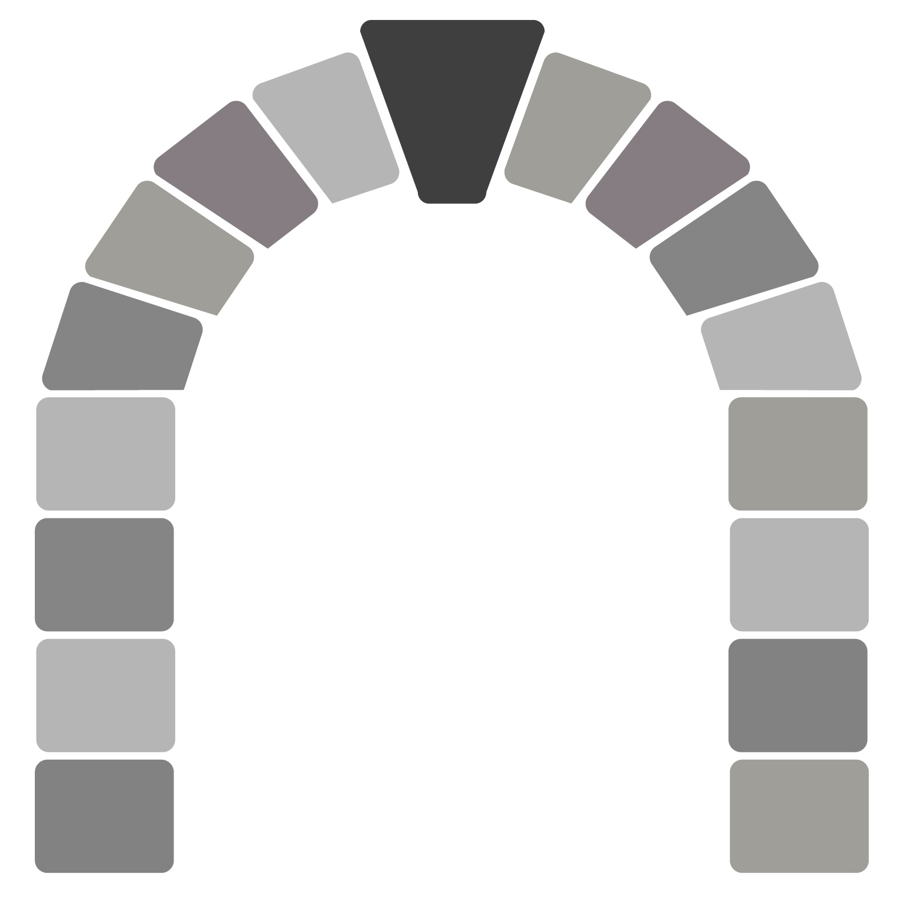
API Overview
The REST API is the true keystone of Kubernetes.
Everything within the Kubernetes is as an API Object.
Image Source
Notes:
API-Server is the keystone to Kubernetes
Every component communicates with it
Everything created within Kubernetes is an API object or resource
This is object-oriented application architecture

Slide 40
API Groups
Designed to make it extremely simple to both understand and extend.
An API Group is a REST compatible path that acts as the type descriptor for a Kubernetes object.
Referenced within an object as the apiVersion and kind.
Format:
/apis/<group>/<version>/<resource>
Examples:
/apis/apps/v1/deployments
/apis/batch/v1beta1/cronjobs
Notes:
Every object in kubernetes belongs to an API Group
The API Group is a REST compatible path that acts as the type descriptor for a Kubernetes object.
apiVersion is the version of the object we’re creating
kind is the specific type of object or resource being created

Slide 41
API Versioning
Three tiers of API maturity levels.
Also referenced within the object apiVersion.
Alpha: Possibly buggy, And may change. Disabled by default.
Beta: Tested and considered stable. However API Schema may change. Enabled by default.
Stable: Released, stable and API schema will not change. Enabled by default.
Format:
/apis/<group>/<version>/<resource>
Examples:
/apis/apps/v1/deployments
/apis/batch/v1beta1/cronjobs
Notes:
Note on how to enable disabled (alpha) features

Slide 42
Object Model
Objects are a “record of intent” or a persistent entity that represent the desired state of the object within the cluster.
All objects MUST have apiVersion, kind, and poses the nested fields metadata.name, metadata.namespace, and metadata.uid.
Notes:
Record of intent may sound odd, but here’s another way of looking at it.
If you order pizza for delivery, you have specified clearly what you want delivered.
This establishes the type of object, the version of the object and a unique identity for the object itself
HOWEVER when defining an object, many fields are optional (namespace can be inherited. UID can be generated)

Slide 43
Object Model Requirements
apiVersion: Kubernetes API version of the Object
kind: Type of Kubernetes Object
metadata.name: Unique name of the Object
metadata.namespace: Scoped environment name that the object belongs to (will default to current).
metadata.uid: The (generated) uid for an object.
apiVersion: v1
kind: Pod
metadata:
name: pod-example namespace: default
uid: f8798d82-1185-11e8-94ce-080027b3c7a6

Slide 44
Object Expression - YAML
Files or other representations of Kubernetes Objects are generally represented in YAML.
A “Human Friendly” data serialization standard.
Uses white space (specifically spaces) alignment to denote ownership.
Three basic data types:
mappings - hash or dictionary,
sequences - array or list
scalars - string, number, boolean etc
Notes:
YAML Ain't Markup Language
“Human friendly”....till things get complicated

Slide 45
Object Expression - YAML
apiVersion: v1
kind: Pod
metadata:
name: yaml
spec:
containers:
- name: container1
image: nginx
- name: container2
image: alpine
Notes:
Super simple example

Slide 46
Object Expression - YAML
apiVersion: v1
kind: Pod
metadata:
name: yaml
spec:
containers:
- name: container1
image: nginx
- name: container2
image: alpine
Scalar
Mapping Hash Dictionary
Sequence Array List

Slide 47
Object Model - Workloads
Workload related objects within Kubernetes have an additional two nested fields spec and status.
spec - Describes the desired state or configuration of the object to be created.
status - Is managed by Kubernetes and describes the actual state of the object and its history.

Slide 48
Workload Object Example
Example Object
apiVersion: v1
kind: Pod
metadata:
name: pod-example
spec:
containers:
- name: nginx
image: nginx:stable-alpine
ports:
- containerPort: 80
Example Status Snippet
status:
conditions:
- lastProbeTime: null
lastTransitionTime: 2018-02-14T14:15:52Z
status: "True"
type: Ready
- lastProbeTime: null
lastTransitionTime: 2018-02-14T14:15:49Z
status: "True"
type: Initialized
- lastProbeTime: null
lastTransitionTime: 2018-02-14T14:15:49Z
status: "True"
type: PodScheduled

Slide 49
Using the API
Lab - github.com/mrbobbytables/k8s-intro-tutorials/blob/master/cli
(aka, using the CLI)

Slide 50
Namespaces
Pods
Labels
Selectors
Services
Core
Objects
Concepts and Resources
Notes:
Ns,pod: Jeff
Labels,Selectors: Bob
Service intro: Jeff

Slide 51
Core Concepts
Kubernetes has several core building blocks that make up the foundation of their higher level components.
Namespaces
Pods
Services
Labels
Selectors

Slide 52
Namespaces
Namespaces are a logical cluster or environment, and are the primary method of partitioning a cluster or scoping access.
apiVersion: v1
kind: Namespace
metadata:
name: prod
labels:
app: MyBigWebApp
$ kubectl get ns --show-labels
NAME STATUS AGE LABELS
default Active 11h <none>
kube-public Active 11h <none>
kube-system Active 11h <none>
prod Active 6s app=MyBigWebApp
Notes:
Think like a scope or even a subdomain
This is a very similar concept to namespaces in programming. In fact it is the same, just for application architecture.

Slide 53
Default Namespaces
default: The default namespace for any object without a namespace.
$ kubectl get ns --show-labels
NAME STATUS AGE LABELS
default Active 11h <none>
kube-public Active 11h <none>
kube-system Active 11h <none>
kube-system: Acts as
the home for objects and resources created by Kubernetes itself.
kube-public: A special namespace; readable by all users that is reserved for cluster bootstrapping and configuration.
Notes:
Kube-system is not exclusive and can have other things placed in it
kube-public is pretty much only seen with kubeadm provisioned clusters

Slide 54
Pod
Atomic unit or smallest “unit of work”of Kubernetes.
Foundational building block of Kubernetes Workloads.
Pods are one or more containers that share volumes, a network namespace, and are a part of a single context.
Notes:
Repetition is your friend here.

Slide 55
Pod Examples
apiVersion: v1
kind: Pod
metadata:
name: pod-example
spec:
containers:
- name: nginx
image: nginx:stable-alpine
ports:
- containerPort: 80
apiVersion: v1
kind: Pod
metadata:
name: multi-container-example
spec:
containers:
- name: nginx
image: nginx:stable-alpine
ports:
- containerPort: 80
volumeMounts:
- name: html
mountPath: /usr/share/nginx/html
- name: content
image: alpine:latest
command: ["/bin/sh", "-c"]
args:
- while true; do
date >> /html/index.html;
sleep 5;
done
volumeMounts:
- name: html
mountPath: /html
volumes:
- name: html
emptyDir: {}
Notes:
Discuss sidecar pattern
This is a good example of a pod having multiple containers

Slide 56
Key Pod Container Attributes
name - The name of the container
image - The container image
ports - array of ports to expose. Can be granted a friendly name and protocol may be specified
env - array of environment variables
command - Entrypoint array (equiv to Docker ENTRYPOINT)
args - Arguments to pass to the command (equiv to Docker CMD)
Container
name: nginx
image: nginx:stable-alpine
ports:
- containerPort: 80
name: http
protocol: TCP
env:
- name: MYVAR
value: isAwesome
command: [“/bin/sh”, “-c”]
args: [“echo ${MYVAR}”]

Slide 57
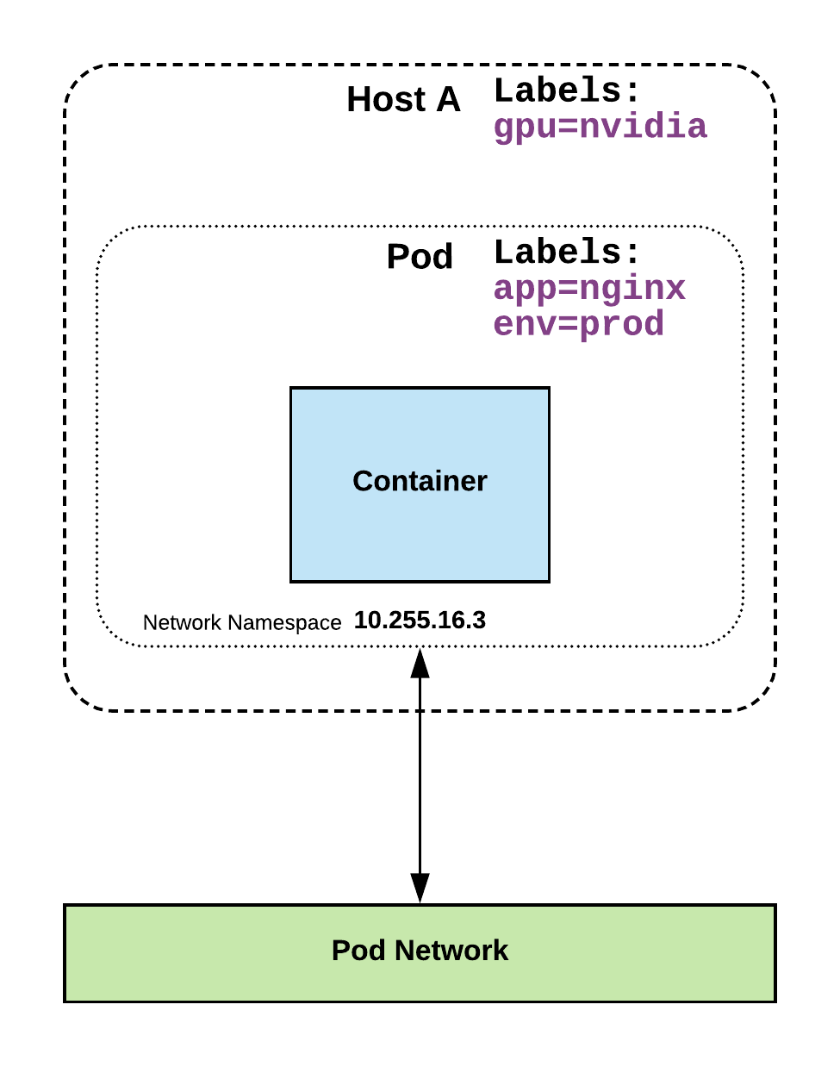
Labels
key-value pairs that are used to identify, describe and group together related sets of objects or resources.
NOT characteristic of uniqueness.
Have a strict syntax with a slightly limited character set*.
* https://kubernetes.io/docs/concepts/overview/working-with-objects/labels/#syntax-and-character-set

Slide 58
Label Example
apiVersion: v1
kind: Pod
metadata:
name: pod-label-example
labels: app: nginx env: prod
spec:
containers:
- name: nginx
image: nginx:stable-alpine
ports:
- containerPort: 80

Slide 59
Selectors
Selectors use labels to filter or select objects, and are used throughout Kubernetes.
apiVersion: v1
kind: Pod
metadata:
name: pod-label-example
labels: app: nginx env: prod
spec:
containers:
- name: nginx
image: nginx:stable-alpine
ports:
- containerPort: 80 nodeSelector:
gpu: nvidia
Notes:
Selectors allow you to create rules based on your labels
NO ‘hard links’ to things, everything is done through labels and selectors

Slide 60
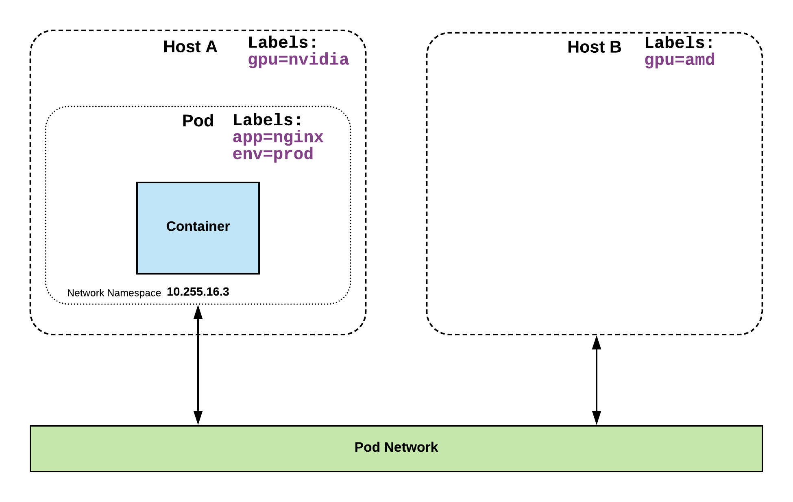
Selector Example
apiVersion: v1
kind: Pod
metadata:
name: pod-label-example
labels: app: nginx env: prod
spec:
containers:
- name: nginx
image: nginx:stable-alpine
ports:
- containerPort: 80 nodeSelector:
gpu: nvidia

Slide 61
Selector Types
Equality based selectors allow for simple filtering (=,==, or !=).
Set-based selectors are supported on a limited subset of objects. However, they provide a method of filtering on a set of values, and supports multiple operators including: in, notin, and exist.
selector:
matchLabels:
gpu: nvidia
selector:
matchExpressions:
- key: gpu
operator: in
values: [“nvidia”]

Slide 62
Services
Unified method of accessing the exposed workloads of Pods.
Durable resource (unlike Pods)
static cluster-unique IP
static namespaced DNS name
<service name>.<namespace>.svc.cluster.local
Notes:
Not ephemeral. Repeat repeat repeat.

Slide 63
Services
Target Pods using equality based selectors.
Uses kube-proxy to provide simple load-balancing.
kube-proxy acts as a daemon that creates local entries in the host’s iptables for every service.
Notes:
This in-turn acts as a simple round-robin load balancer among the Pods targeted by the selector.
More options coming

Slide 64
Service Types
There are 4 major service types:
ClusterIP (default)
NodePort
LoadBalancer
ExternalName
Notes:
clusterIP,LB - Bob
Nodeport,External - Jeff

Slide 65
ClusterIP Service
ClusterIP services exposes a service on a strictly cluster internal virtual IP.
apiVersion: v1
kind: Service
metadata:
name: example-prod
spec:
selector:
app: nginx
env: prod
ports:
- protocol: TCP
port: 80
targetPort: 80
Notes:
ClusterIP is an internal LB for your application

Slide 66
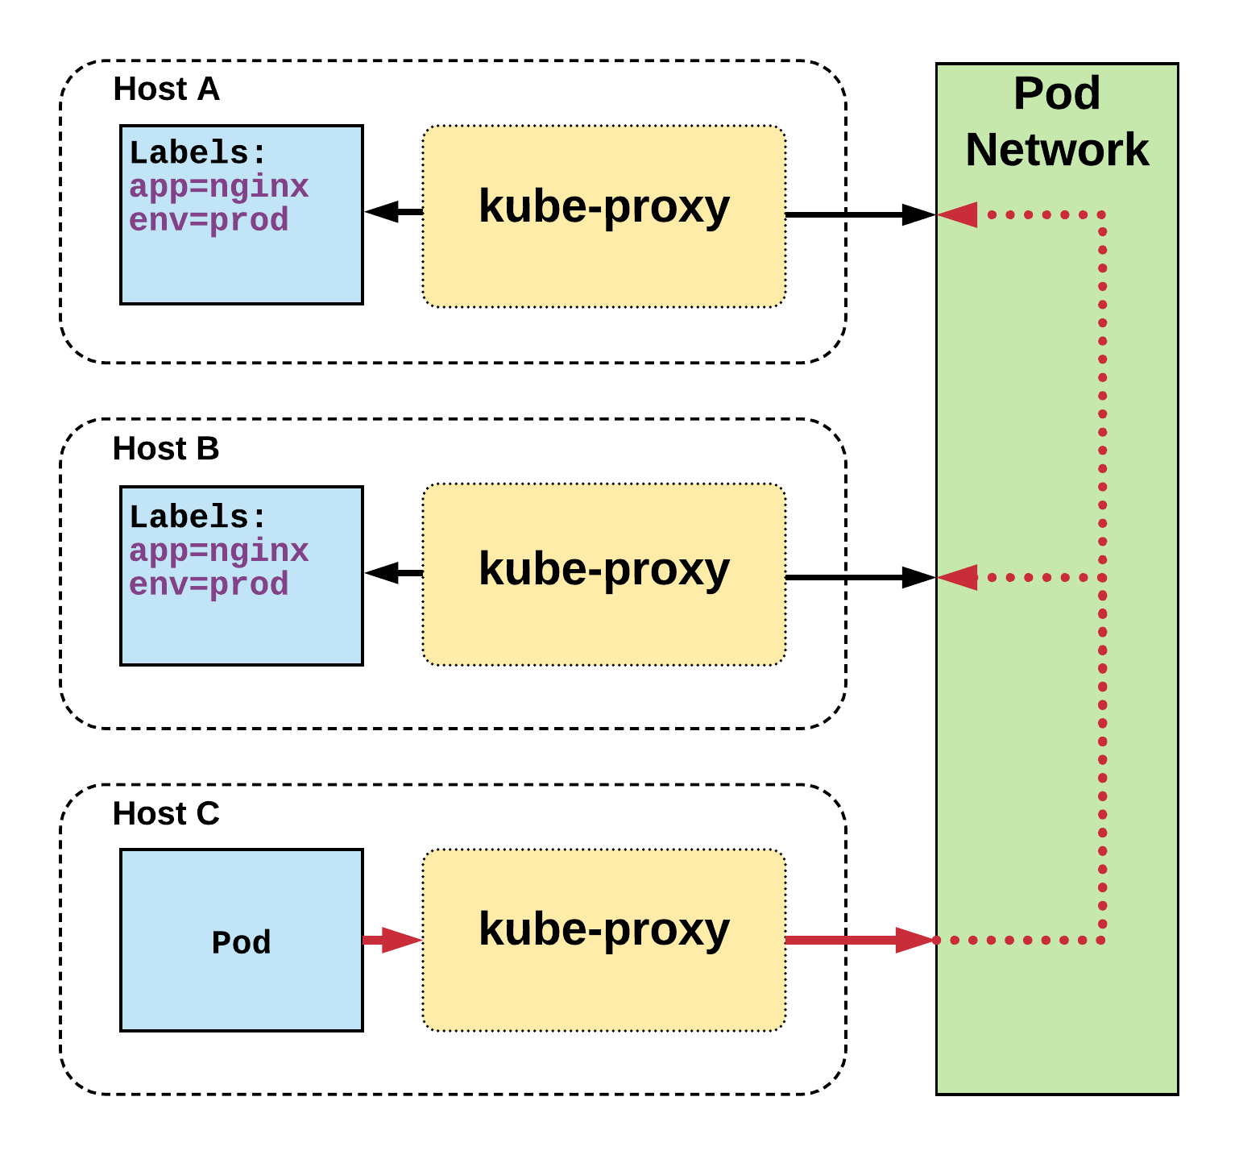
Cluster IP Service
Name: example-prod
Selector: app=nginx,env=prod
Type: ClusterIP
IP: 10.96.28.176
Port: <unset> 80/TCP
TargetPort: 80/TCP
Endpoints: 10.255.16.3:80, 10.255.16.4:80
/ # nslookup example-prod.default.svc.cluster.local
Name: example-prod.default.svc.cluster.local
Address 1: 10.96.28.176 example-prod.default.svc.cluster.local
Notes:
The Pod on host C requests the service
Hits host iptables and it load-balances the connection between the endpoints residing on Hosts A, B

Slide 67
NodePort Service
NodePort services extend the ClusterIP service.
Exposes a port on every node’s IP.
Port can either be statically defined, or dynamically taken from a range between 30000-32767.
apiVersion: v1
kind: Service
metadata:
name: example-prod
spec:
type: NodePort
selector:
app: nginx
env: prod
ports:
- nodePort: 32410
protocol: TCP
port: 80
targetPort: 80
Notes:
NodePort behaves just like ClusterIP, except it also exposes the service on a (random or specified) port on every Node in your cluster.

Slide 68
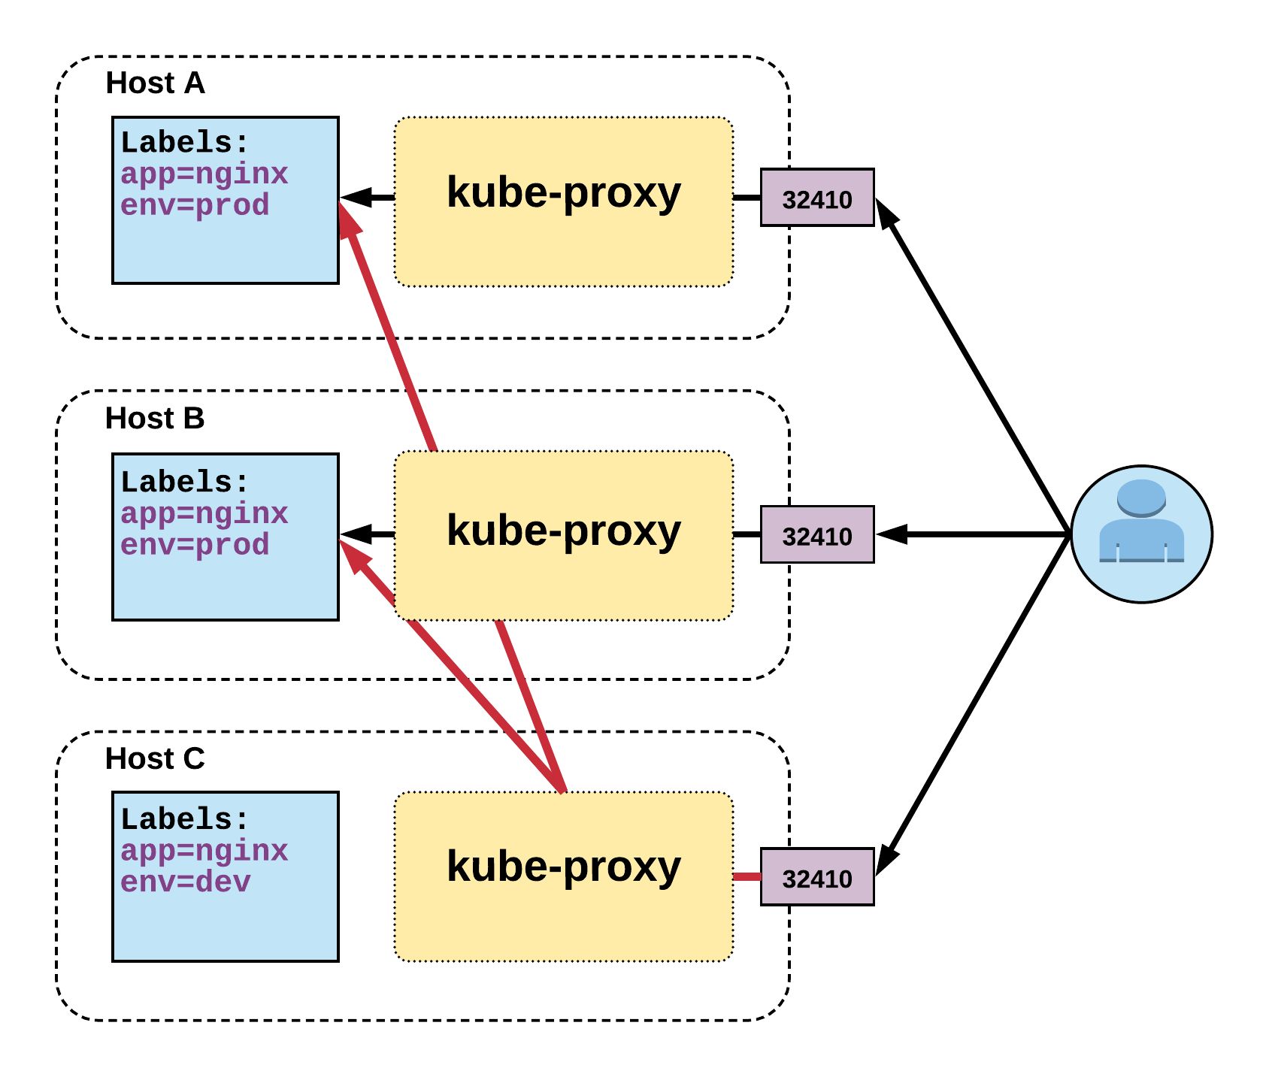
NodePort Service
Name: example-prod
Selector: app=nginx,env=prod
Type: NodePort
IP: 10.96.28.176
Port: <unset> 80/TCP
TargetPort: 80/TCP
NodePort: <unset> 32410/TCP
Endpoints: 10.255.16.3:80, 10.255.16.4:80
Notes:
User can hit any host in cluster on nodeport IP and get to service
Does introduce extra hop if hitting a host without instance of the pod

Slide 69
LoadBalancer Service
LoadBalancer services extend NodePort.
Works in conjunction with an external system to map a cluster external IP to the exposed service.
apiVersion: v1
kind: Service
metadata:
name: example-prod
spec:
type: LoadBalancer
selector:
app: nginx
env: prod
ports:
protocol: TCP
port: 80
targetPort: 80
Notes:
Continue to get abstracted and built on top of one another.
The LoadBalancer service extends NodePort turns it into a highly-available externally consumable resource.
-Must- Work with some external system to provide cluster ingress

Slide 70
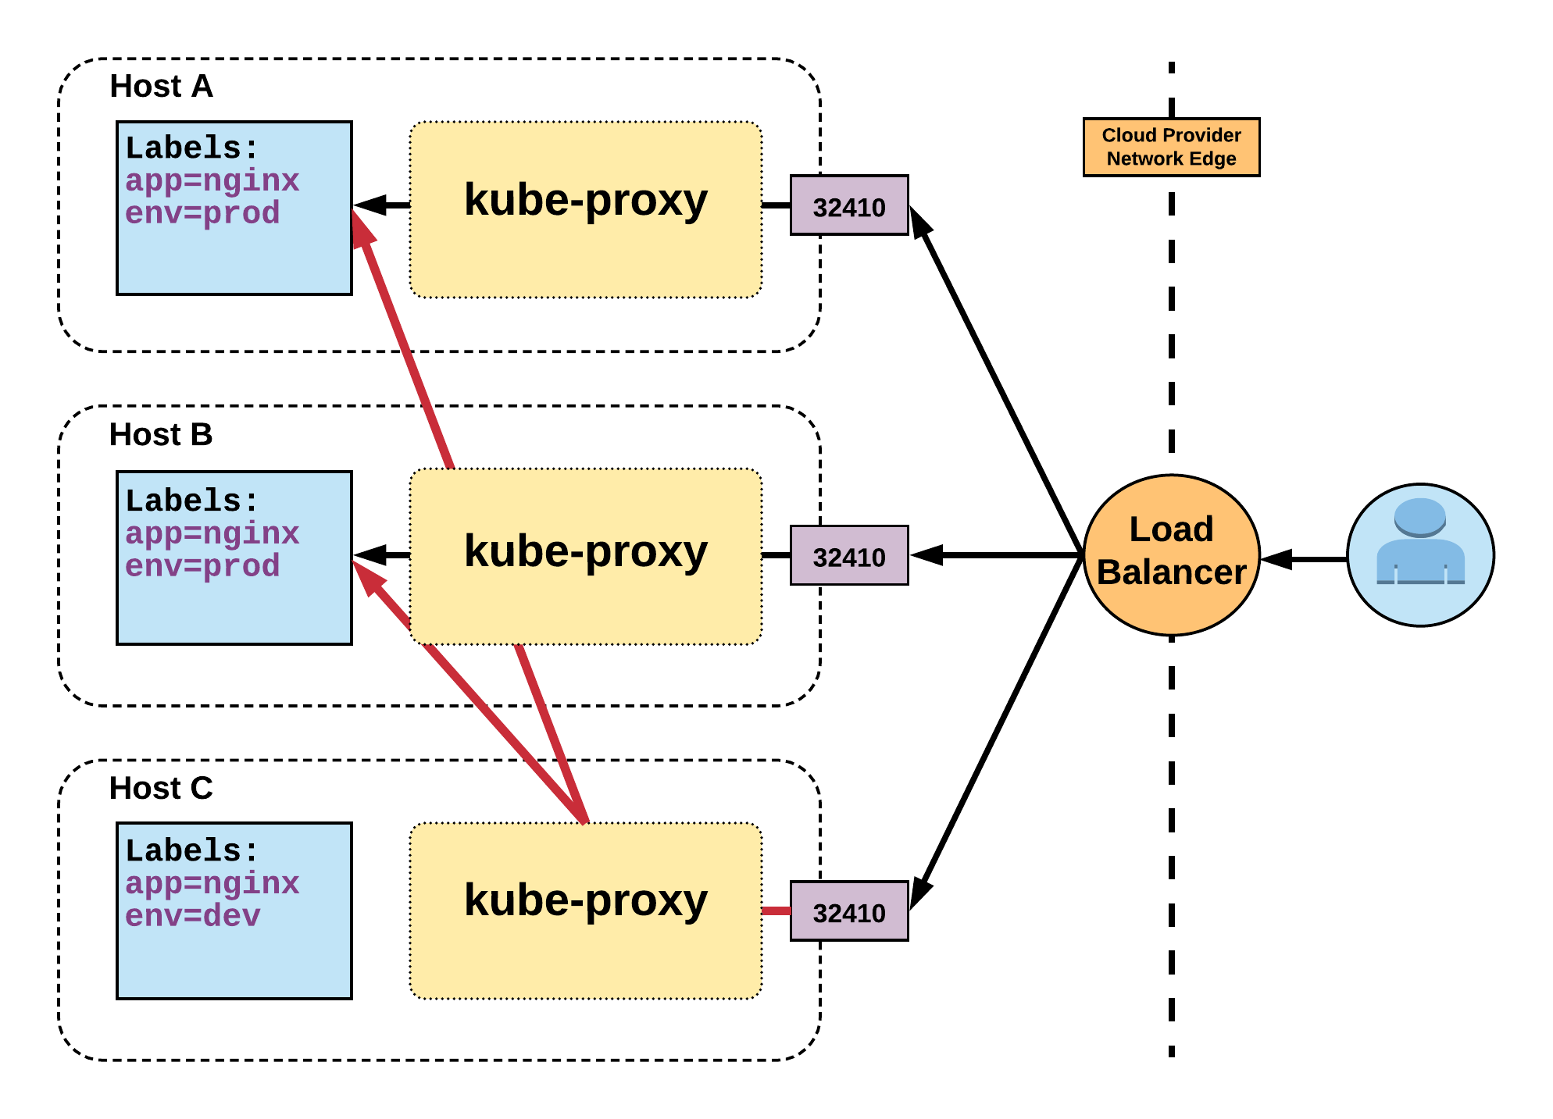
LoadBalancer Service
Name: example-prod
Selector: app=nginx,env=prod
Type: LoadBalancer
IP: 10.96.28.176
LoadBalancer Ingress: 172.17.18.43
Port: <unset> 80/TCP
TargetPort: 80/TCP
NodePort: <unset> 32410/TCP
Endpoints: 10.255.16.3:80, 10.255.16.4:80
Notes:
Gets external IP from provider
There are settings to remove nodes that are not running an instance of the pod. To remove extra hop.

Slide 71
ExternalName Service
ExternalName is used to reference endpoints OUTSIDE the cluster.
Creates an internal CNAME DNS entry that aliases another.
apiVersion: v1
kind: Service
metadata:
name: example-prod
spec:
type: ExternalName
spec:
externalName: example.com
Notes:
Allows you to point your configs and such to a static entry internally that you can update out of band later

Slide 72
Where to go From Here

Slide 73
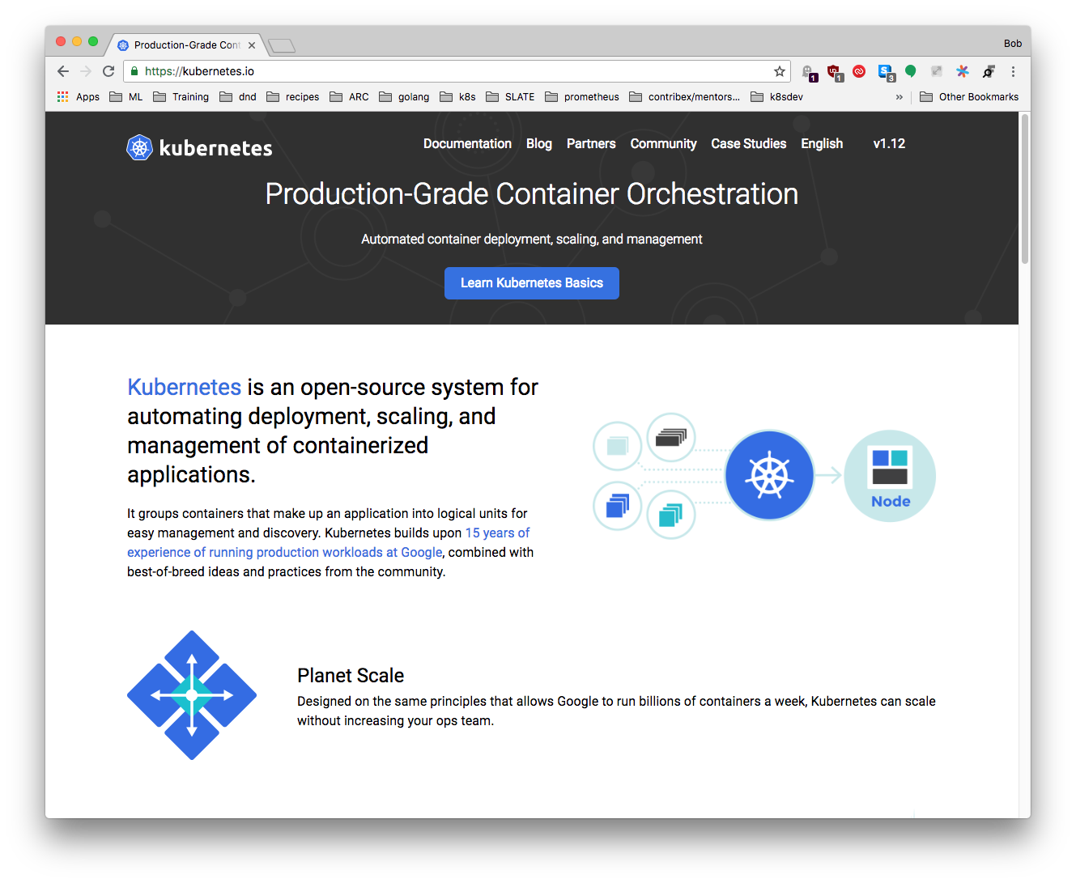
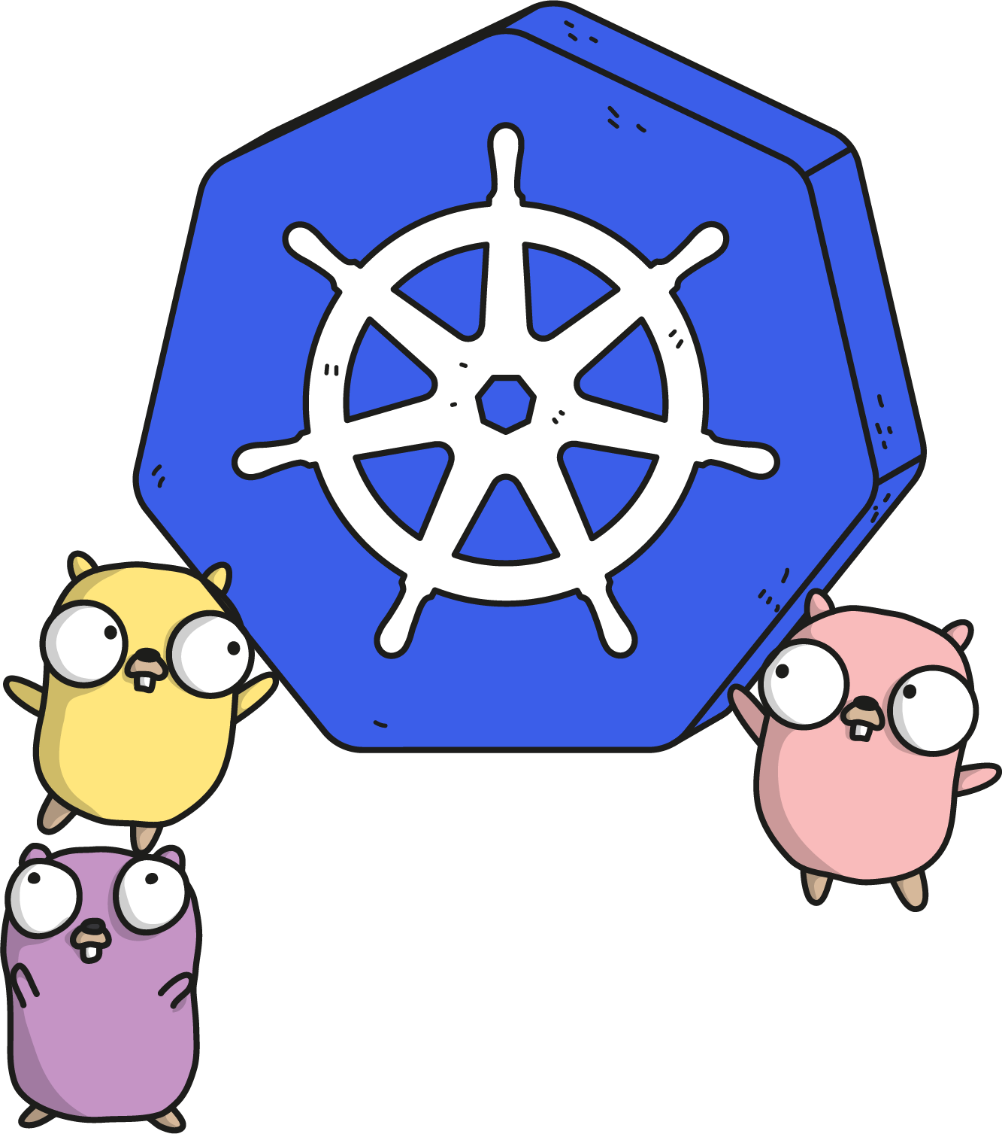
kubernetes.io
Documentation
Examples
API Reference
Notes:
Community driven, constantly updated. The documentation and API references are updated with each release.
There’s an entire group dedicated to this effort.

Slide 74

Slack
Kubernetes
slack.k8s.io
70,000+ users
300+ public channels
CNCF
slack.cncf.io
8,200+ users
70+ public channels
07/2019
Notes:
Two main slacks to be aware of.
The Kubernetes slack has a lot of activity and can be a good place to ask questions or connect with other users.
The CNCF slack isn’t for support, but more for policy and connecting with other places looking to use cloud native technology.
There is also an #academia channel within the CNCF slack that we frequent.

Slide 75


Other Communities
Official Forum https://discuss.kubernetes.io
Subreddit https://reddit.com/r/kubernetes
StackOverflow https://stackoverflow.com/questions/tagged/kubernetes
Notes:
Discuss has taken the place of our old mail group. It is active and many community members watch and answer questions.
There is a Kubernetes subreddit, albeit unofficial, that has some activity.
Finally Kubernetes-tagged Stack Overflow questions are monitored and that activity is even tracked and charted for community engagement.

Slide 76
Meetups
Kubernetes
meetup.com/topics/kubernetes/
850+ groups
380,000+ members
CNCF
meetups.cncf.io
200+ groups
120,000+ members
45+ countries
07/2019
Notes:
Engaging in the community is a great way to stay on top of changes and foster new ideas.
These are a couple good resources to find a meetup near you. We run our own out of Ann Arbor, and hopefully there’s one near you.

Slide 77
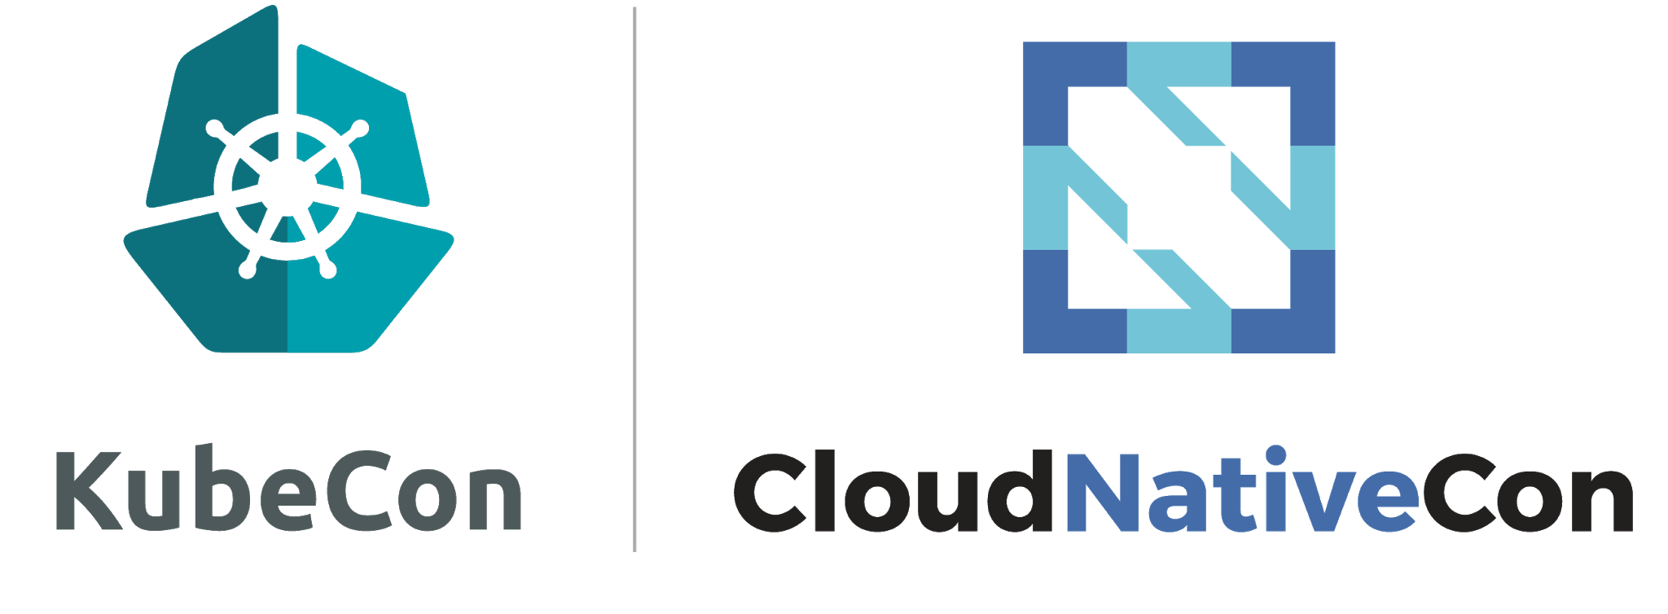
Conventions
China: TBD
Europe: March 30 – April 2, 2020 Amsterdam, Netherlands
North America: November 18 - 21, 2019 San Diego, CA
07/2019
Notes:
In lieu of a meetup, there are several large conventions that focus on showcasing end users of this technology. At KubeCon US we’re looking to host an academic lunch and once things are finalized we’ll get details out.

Slide 78
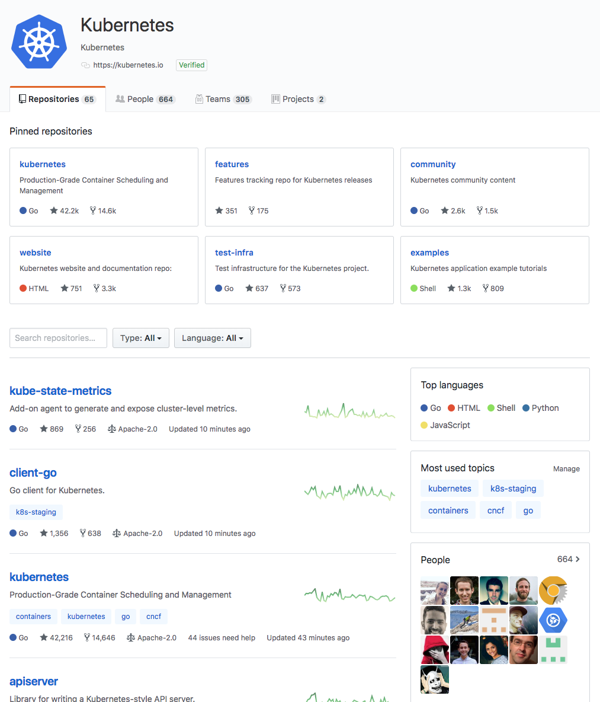
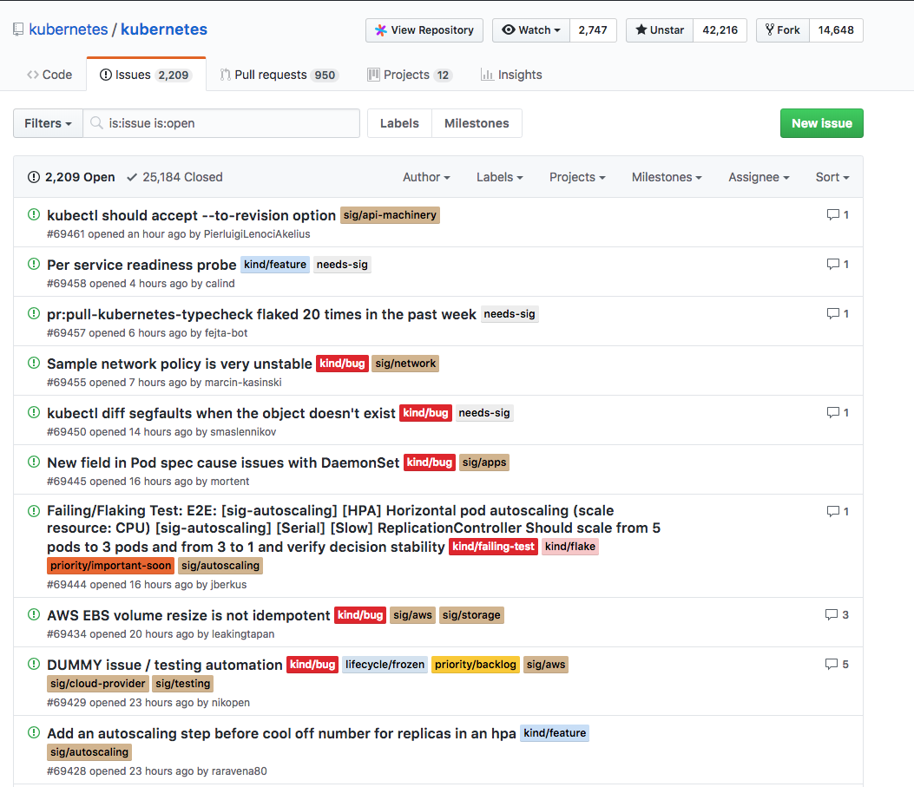
GitHub
Notes:
The last main resource is the Kubernetes GitHub Org and Repos.
This can cause shell shock, but it’s worth noting how things are structured.
There are a lot of different repos within the org because the code base is structured into many sub-projects.
Responsibility for maintaining and organizing code changes falls to various groups

Slide 79
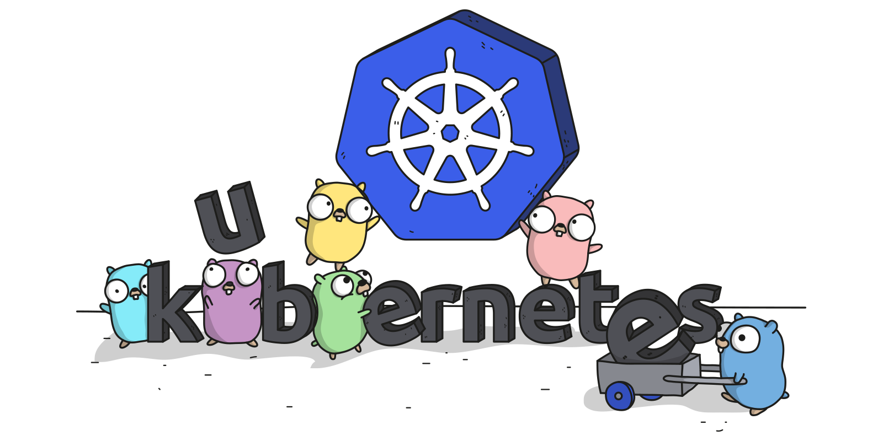
Links
Free Kubernetes Courses https://www.edx.org/
Interactive Kubernetes Tutorials https://www.katacoda.com/courses/kubernetes
Learn Kubernetes the Hard Way https://github.com/kelseyhightower/kubernetes-the-hard-way
Official Kubernetes Youtube Channel https://www.youtube.com/c/KubernetesCommunity
Official CNCF Youtube Channel https://www.youtube.com/c/cloudnativefdn
Track to becoming a CKA/CKAD (Certified Kubernetes Administrator/Application Developer) https://www.cncf.io/certification/expert/
Awesome Kubernetes https://ramitsurana.gitbooks.io/awesome-kubernetes/content/

Slide 80
Questions?

